Slide 1

Session 8 (of 24)
PGR112 Objektorientert programmering
Yuan Lin / yuan.lin@kristiania.no

Slide 2
Today’s Main Goal
A Recap to Inheritance & Aggregation
IS-A
HAS-A
Abstract
Abstract class
Abstract method
@Override annotation
Static
Try-with-resoures
HashMap
Practice Time

Slide 3
Status
Step 1: IntelliJ, Git, Hello World
Step 2: Variable, Method, Data type, Scope, Control statement
Step 3: Class, Object, Scanner, Encapsulation
Step 4: Package, Import, Modifiers, Overload, ArrayList, Enums
Step 5: Scanner (cont.), Input validation, Debugger, Write test
Step 6: Exception handling, File I/O, Logger, Date/Time
Step 7: Inheritance, Aggregation, Super, Final
Now: Abstract
…

Slide 4
A Recap to Inheritance
What is inheritance?
Inheritance means that you can create new classes built upon existing classes
Inheritance represents IS-A relationship.
How to obtain inheritance?
Extends is the keyword
We understood how sub-class can inherit from parent-class
Reuse of code
Notes:
Any one can give more examples?

Slide 5
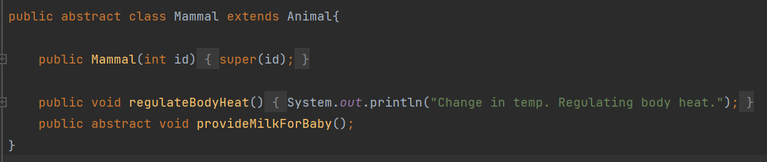
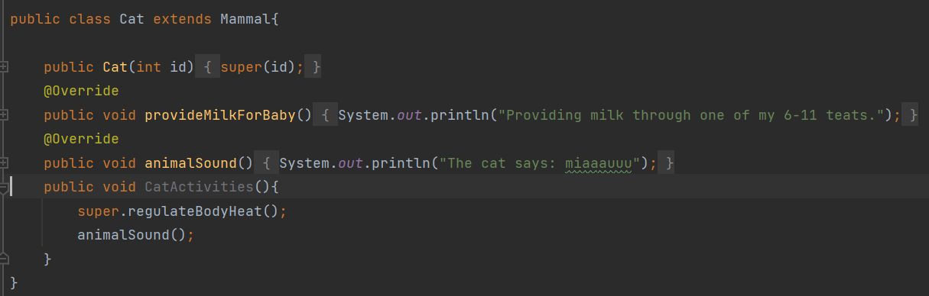
A Recap to Super
Use of Super keyword
super can refer to immediate parent class object
super.methodname() can be used to invoke parent class method
super() can be used to invoke parent class parameterized or default constructor
Notes:
Any one can give more examples?

Slide 6
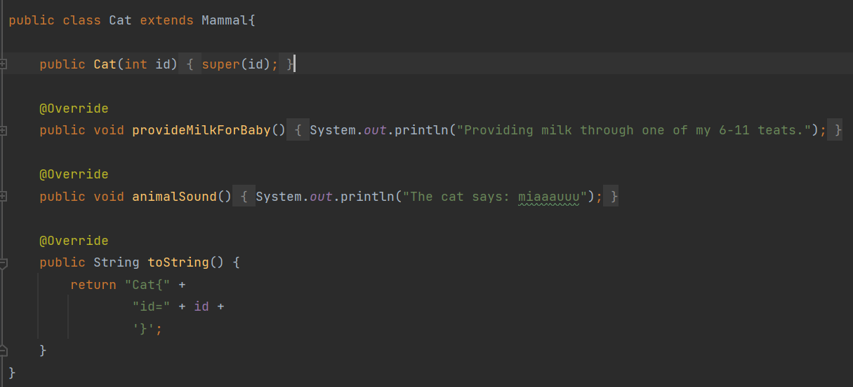
Is-a
We should use inheritance with caution, only in context of “is-a”
Inheritance provides a string link between two classes
Notes:
Any one can give more examples?

Slide 7
A Recap Aggregation
What is aggregation?
If a class have an entity reference, it is known as Aggregation.
Aggregation represents Has-a relationship.
Why use aggregation?
Inheritance should be used only when the Is-a relationship is maintained throughout the lifetime of the objects involved
Otherwise aggregation is the best choice
We also talked about composition, but will not emphasize it in this topic.
Notes:
Any one can give more examples?

Slide 8
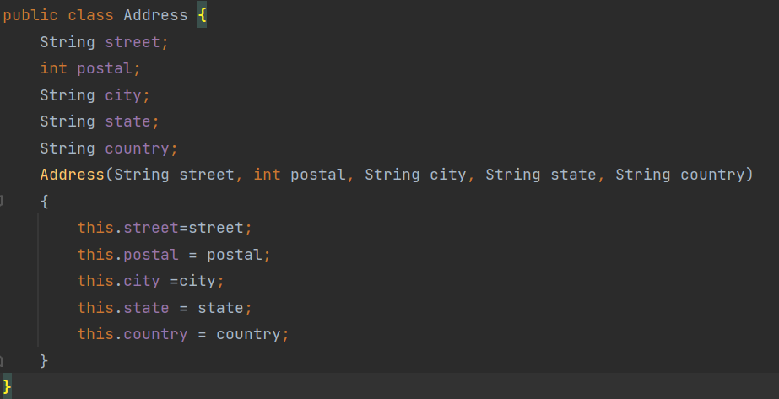
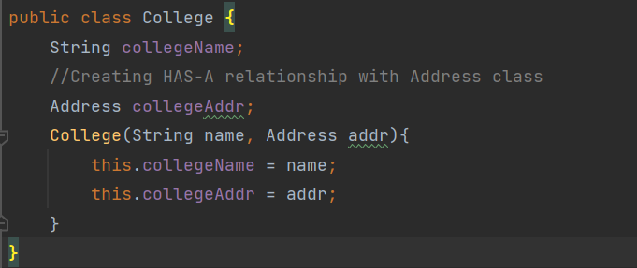
Has-a
Code re-use can be best achieved when there is no Is-a relationship
In Java, has-a simply means that an instance of one class has a reference to an instance of another class.
Both classes are independent. They can exist without each other.
Notes:
Any one can give more examples?

Slide 9
So – What is Abstraction?
The essence of abstraction is preserving information that is relevant in a given context, and forgetting information that is irrelevant in that context (John V. Guttag)
What does this exactly mean?
We want to hide implementation details
We show only functionality to the user.
We can perform abstraction using two mechanisms in Java
Abstract (this lecture) . Achieves 0-100% abstraction
Interface (next lecture) – achieves 100% abstraction
Q: Inheritance has to have abstraction?
A : The answer is no. But abstraction is a good coding practice
Notes:
Any one can give more examples?

Slide 10
Abstract
Abstract reserved keyword can be applied to
Abstract class
Abstract method
Notes:
Any one can give more examples?

Slide 11
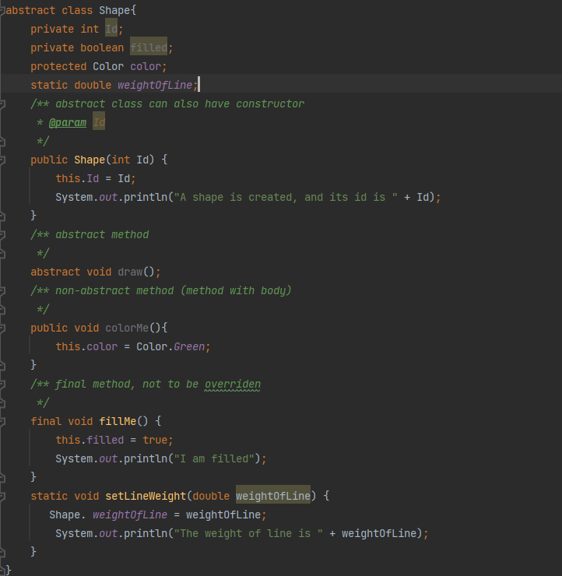
Some rules for abstract classes
An abstract class must be declared with the abstract keyword
Abstract class can have abstract and non-abstract method (method with body)
Abstract class can not be instantiated
Abstract class can have constructors and static methods
Why static method is allowed? Because static method can be called directly without an instance.
Abstract class can have final methods which forces subclasses not to change the body of the method.
Notes:
Any one can give more examples?

Slide 12
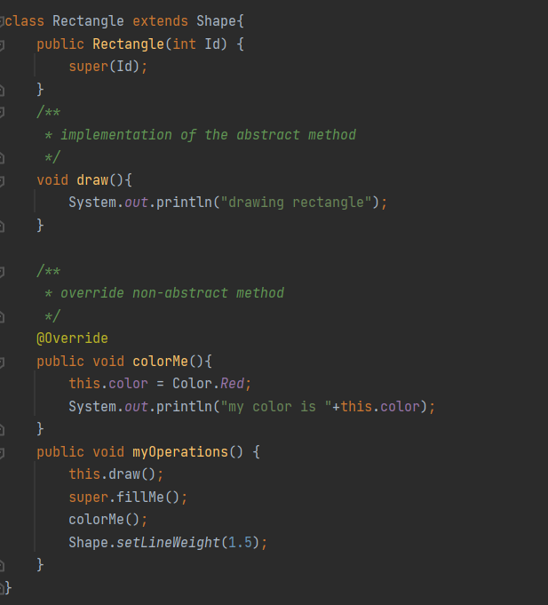
Some rules for abstract classes
Do you notice how Super keyword is used here?
And do you notice how Static is used here?
Notes:
Any one can give more examples?

Slide 13
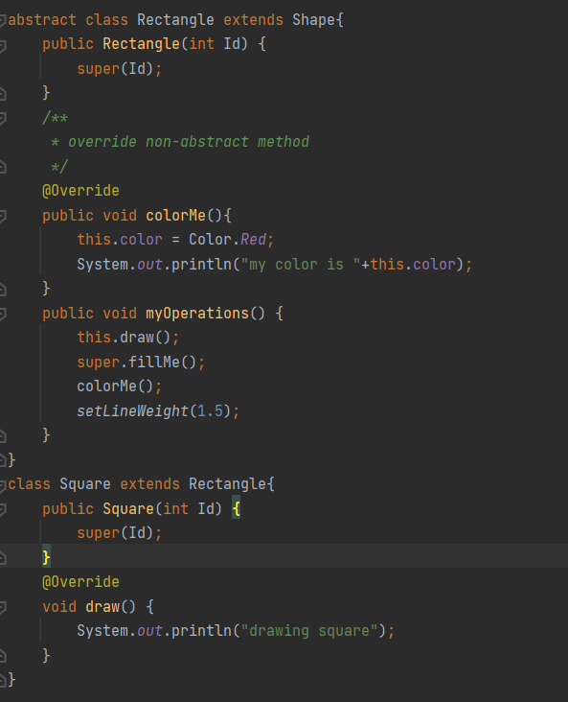
Abstract methods
Abstract methos is a method declared as abstract and has no implementations
Abstract methods can only be declared in abstract class.
The child class thus must ensure that the abstract methods are implemented. But do they HAVE to do it?
No ☺
If the child class does not implement it, the class must be abstract.
Notes:
Any one can give more examples?

Slide 14
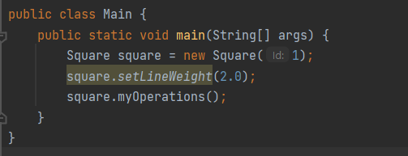
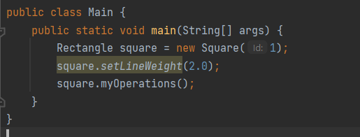
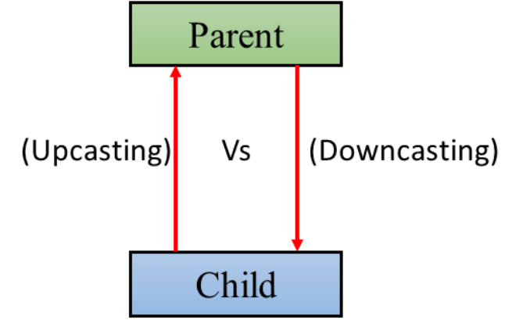
Abstract methods
Note that both apply.
This is called upcasting. Upcasting is the typecasting of a child object to a parent.
//upcasting
Parent o = new Child();
From geeksforgeeks
Notes:
Any one can give more examples?

Slide 15
@Override Annotation
The @Override annotation indicated that the child class method is overwriting its base class method (with method body).
All it does is validate that a superclass method with the same signature exists.
Abstract method doesn’t need @Override annotation.
Do we HAVE TO use @Override annotation?
No ☺ It is not necessary, but highly recommended. Why?
If the annotated method doe not actually override anything, the compiler issues a warning
It can help to make the source code more readable.
Notes:
Any one can give more examples?

Slide 16
Static
Static is applicable for Blocks, Variables, Methods, Classes
When a member is declared static, it can be accessed before any objects of its class are created, or without reference to any object.
Static variables:
All instances of the class share the same static variable. Static variable can be accessed by non-static method.
In Java, static variables can only be created at class level. Not allowed in local methods.
Static methods:
They can only directly call other static methods
They can only directly access static variables
They cannot refer to this – why?
Notes:
Examples of Final and Static

Slide 17
Static
Abstract class can have static methods
Why static method is allowed? Because static method can be called directly without an instance.
Can Static method be abstract in Java?
No ☹ Why?
When a method is described as abstract by using the abstract type modifier, it becomes responsibility of the subclass to implement it
When a method is described as static, it makes it clear that this static method cannot be overridden by any subclass. Because static members are compile-time elements, while overriding them will make it runtime elements.
Thus Abstract static method is not allowed in Java.
Notes:
Examples of Final and Static

Slide 18
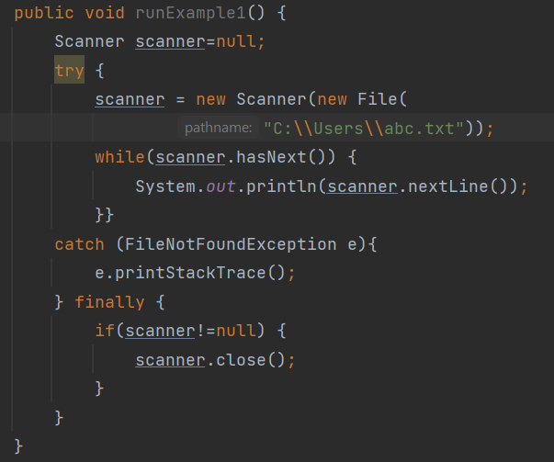
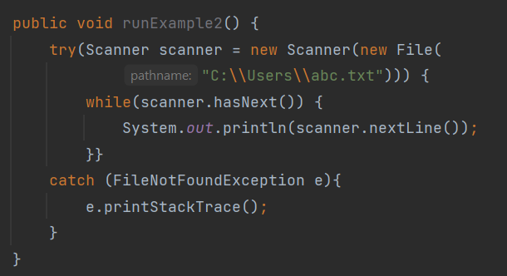
Try-with-resources
Replacing try-catch-finally with try-with-resources
We can declare one or more resources
With try-catch-finally clause, you use finally block to ensure that a resource is closed
With try-with-resources, resource is closed automatically

Slide 19
HashMap
Using ArrayList has some downsides
If we want to retrieve one specific object (without knowing the index), then it’s a bit cumbersome.
Let’s look at an alternative: HashMap…
Notes:
Any one can give more examples?

Slide 20
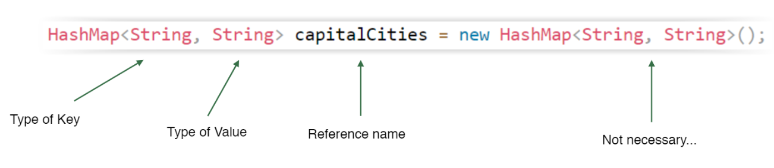
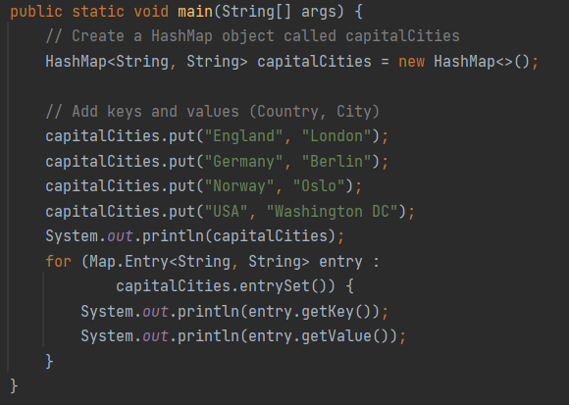

HashMap
Create HashMap
Use HashMap
Notes:
Any one can give more examples?

Slide 21
Some rules about HashMap
Java HashMap allows us to store key and value pair.
Java HashMap Is great to use if we want to find an object based on a key.
Java HashMap contains only unique keys.
If you try to insert the duplicate key, it will replace the element of the corresponding key.
Java HashMap may have one null key and multiple null values.
Java HashMap maintains no order
We can put objects of defined types and sub-types.
HashMap class is found in java.util package.
Notes:
Any one can give more examples?

Slide 22
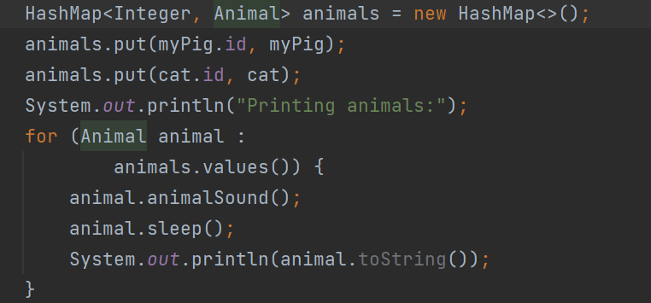
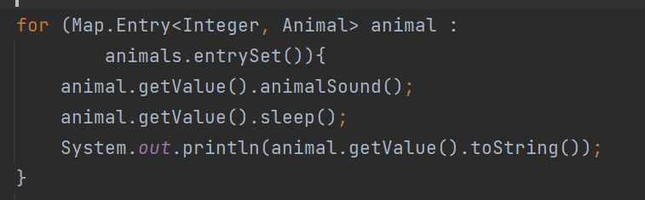
Iterating over objects in a HashMap
Iterate over HashMap can be done in many different ways.
We can use value() method
We can use entrySet() method
Notes:
Any one can give more examples?

Slide 23
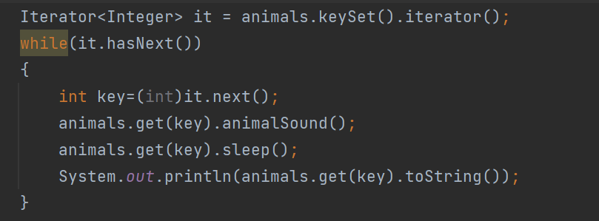
Iterating over objects in a HashMap
We can also use Iterator interface
Notes:
Any one can give more examples?

Slide 24
Before we end
Goals for this session:
I can use abstract classes, and I understand what that means
I can use abstract methods, and I understand what that means
I understand what aggregation entails
I know Static
I understand why we use @Override annotation
I know how to use try-with-resources
I know how to use a HashMap
Remember, do not just read code, play with it. Good luck with the tasks! Remember, there is help available all week, use Mattermost or GitHub.

